Slide 1




Nicky Verslycken
QoS for streaming and live internet calls
Notes:
Hi, I’m Nicky.
I’m from Belgium and working as Field Operations Manager for SmartEye that’s a Mikrotik distributor and network design, implementator and mentainer office
Today I will give a 1-hour course about Quality of Service, in short QoS, for streaming and live internet calls.
With this little improvement upon the basic router configuration we will improve the user experience when they have live video and audio calls in limited bandwidth networks where every Mb counts.
We will prioritize live internet calls above streaming and other traffic

Slide 2
Theory
What is QoS
Why using QoS
How to implement QoS
Practice
Router basic configuration ROS V6 or V7
Firewall
Queue
Testing
Play time / questions & answers
Quiz
Nicky Verslycken
QoS for streaming and live internet calls
Notes:
For reaching our goals we will work in little steps.
First we will configure the device as a router with al there basic components on the most easy way with Quick Set and connect them to the uplink network that’s connected to the internet
Then we will prepare 2 address lists for later use in the firewall mangle rules
After that we will create the necessary firewall mangle rules that we need for our QoS configuration
As last part of our configuration we will configure the QoS rules themselves
When everything is configured we will test our configuration and monitor or the QoS rules do their work

Slide 3


General information
Nicky Verslycken
QoS for streaming and live internet calls
Communication channel
You can chat in the group and get general information in the Discord channel I created for this 1 hour course.
Name: NV-TTT
URL: t.ly/ezONZ
Notes:
The first time you login on the router it will ask you to set the password, please do so

Slide 4


General information
Nicky Verslycken
QoS for streaming and live internet calls
Script and document repositry
On Github I created a repository with all
the scripts and documents you need in
this 1h course.
(You can find this info also in the Discord channel)
Name: MKT-TTT-QoS
URL: https://t.ly/SjXs
Notes:
The first time you login on the router it will ask you to set the password, please do so

Slide 5
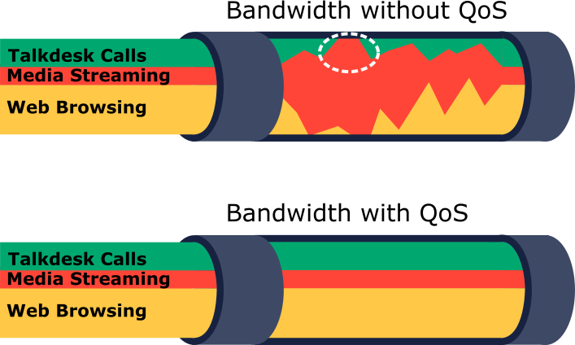
Theory – What is QoS
Nicky Verslycken
QoS for streaming and live internet calls
QoS stands for Quality of Service, and it refers to the ability to provide a guaranteed level of service quality to network traffic.
Media streaming consumes all the traffic at this one moment in the example
Here is traffic not shaped without any guarantee of service
Here is traffic shaped and will the most important traffic receive a guarantee of service
Notes:
In a network, different types of traffic have different requirements, and some traffic may be more important than others.
QoS allows network administrators to prioritize certain types of traffic over others to ensure that the most important traffic receives the necessary bandwidth, latency, and other network resources.
QoS can be used in various network technologies, including local area networks (LANs), wide area networks (WANs), etc.
It is commonly used in real-time applications, such as voice and video conferencing, online gaming, and other time-sensitive traffic.
QoS can be implemented through various techniques, such as traffic shaping, traffic policing, and traffic classification.
It is often an essential feature for businesses and organizations that rely on networked services to maintain their operations.

Slide 6
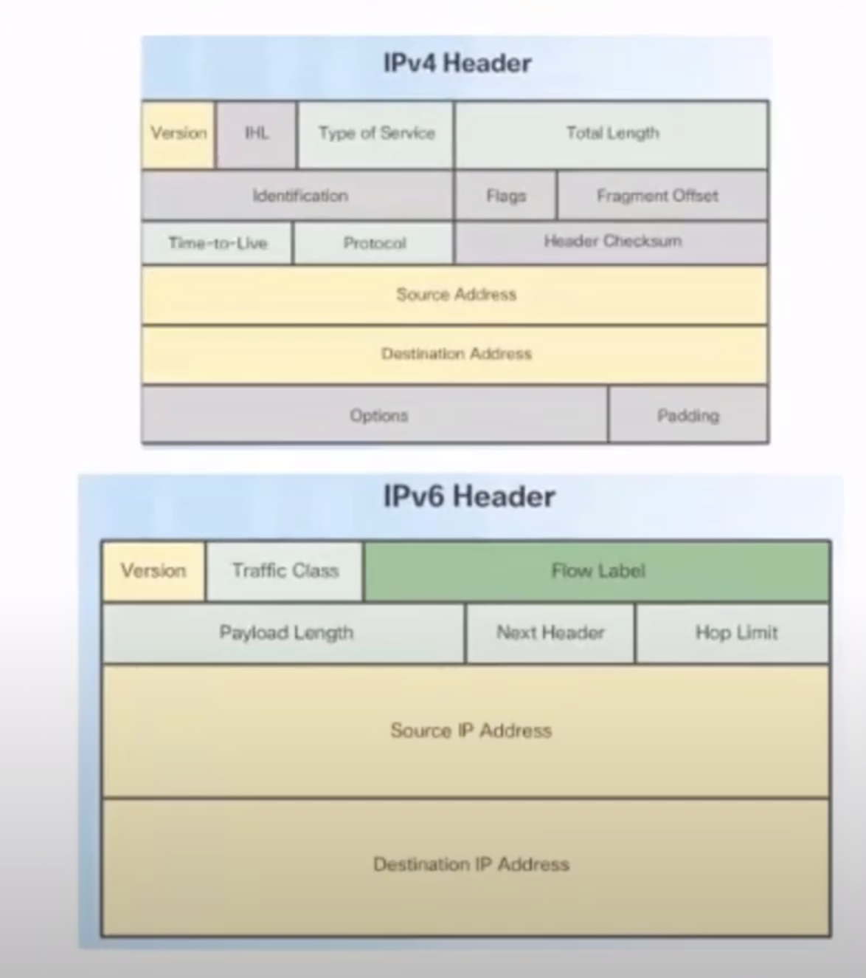
Theory – What is QoS – key terms
Nicky Verslycken
QoS for streaming and live internet calls
IP packet headers
In the IPv4 header the Prioritization will be stored in the “Type of Service field”.
In the IPv6 header will it be stored in the Traffic Class.

Slide 7
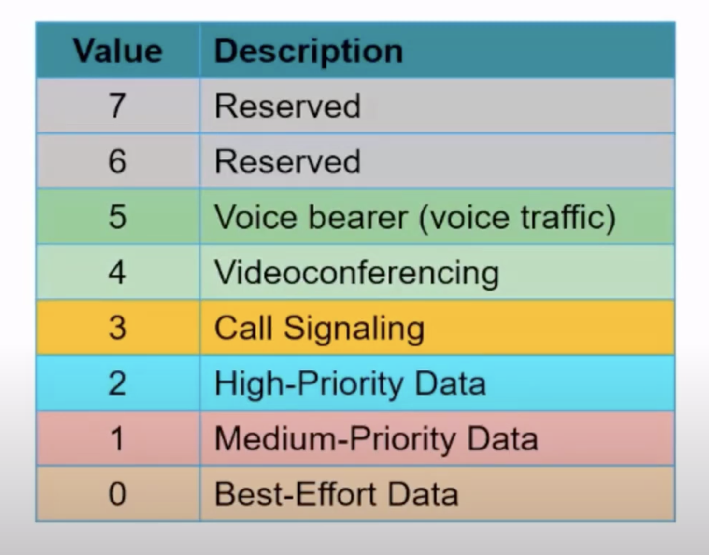
Theory – What is QoS – key terms
Nicky Verslycken
QoS for streaming and live internet calls
Prioritization
giving higher priority to certain types of traffic over others.
Notes:
This is a standard Prioritization scheme for traffic (note that they are numbered from 0 to 7 and not 1 to 8 like in Mikrotik configuration)

Slide 8
Theory – What is QoS – key terms
Nicky Verslycken
QoS for streaming and live internet calls
Example Prioritization
In Mikrotik we will use a numeric value from 1 to 8 where 1 has the highest priority.
1 | VoIP & Video conferencing traffic
2 | Gaming traffic
3 | Video streaming & Remote desktop traffic
4 | Web browsing traffic & Email traffic
5 | File download & Instant messaging traffic
6 | P2P traffic
7 | Backup traffic
8 | All other traffic
Notes:
To prioritize traffic in queues in MikroTik RouterOS, you can use the "priority" parameter in the queue tree settings. Here are the general steps:
Identify the traffic classes: First, you need to identify the types of traffic on your network that require prioritization. For example, you may want to prioritize voice traffic, video streaming traffic, or online gaming traffic.
Create a traffic classification: Once you have identified your network traffic, you need to create a traffic classification for each type of traffic. This can be done using the MikroTik RouterOS firewall filter rules.
Create a traffic marking: After creating traffic classifications, you need to create traffic markings for each traffic class. Traffic marking is the process of tagging each packet with a specific mark value.
Create a traffic queue: Next, you need to create traffic queues for each traffic class. In the queue tree settings, you can use the "priority" parameter to specify the priority level for each queue.
Apply the traffic queue to the interface: Finally, you need to apply the traffic queue to the interface that connects to the network where the traffic is flowing.

Slide 9
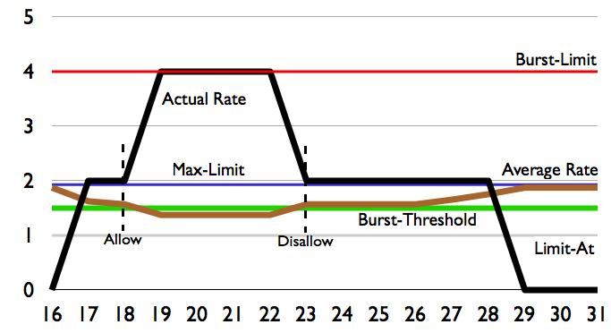
Theory – What is QoS – key terms
Nicky Verslycken
QoS for streaming and live internet calls
Limit At: guaranteed amount of bandwidth.
Max-limit: the maximum the que can use considering the “Limit At”, priority and available bandwidth.
Burst: A temporary higher speed that can be reached, calculated on burst-limit (amount of data), burst-time, burst-threshold (allows burst depending on average data rate)
Notes:
limit-at (NUMBER/NUMBER) : normal upload/download data rate that is guaranteed to a target
max-limit (NUMBER/NUMBER) : maximal upload/download data rate that is allowed for a target to reach to reach what
burst-limit (NUMBER/NUMBER) : maximal upload/download data rate which can be reached while the burst is active
burst-time (TIME/TIME) : period of time, in seconds, over which the average upload/download data rate is calculated. (This is NOT the time of actual burst)
burst-threshold (NUMBER/NUMBER) : when average data rate is below this value - burst is allowed, as soon as average data rate reach this value - burst is denied. (basically this is burst on/off switch). For optimal burst behavior this value should above limit-at value and below max-limit value

Slide 10
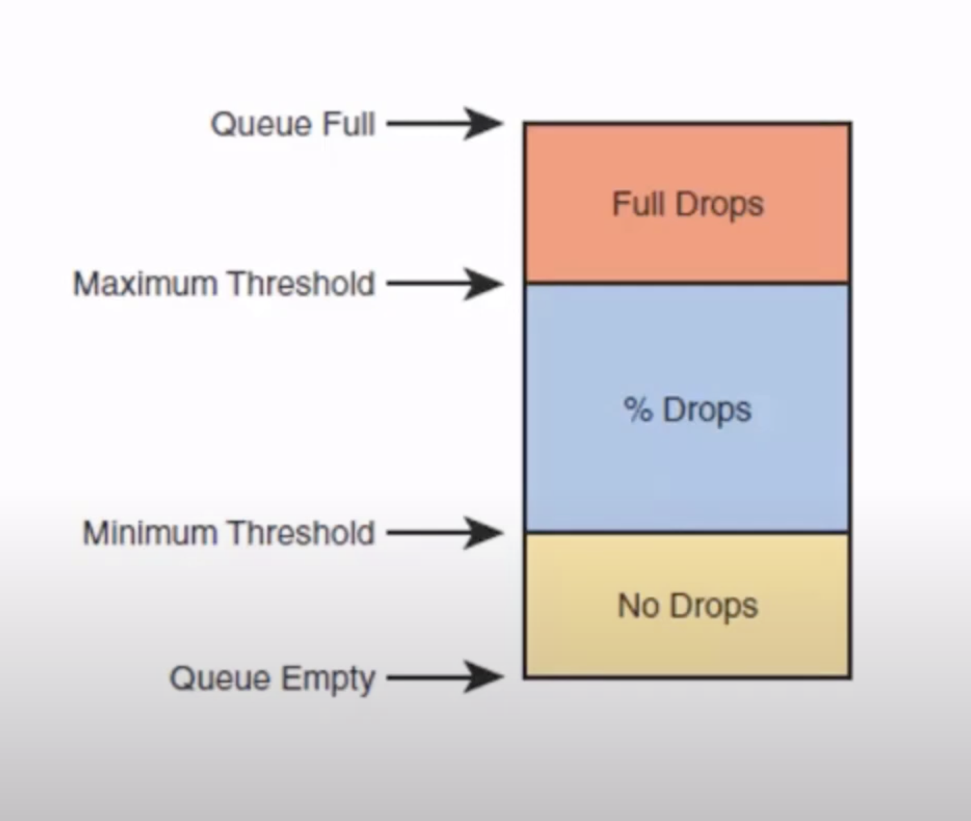
Theory – What is QoS – key terms
Nicky Verslycken
QoS for streaming and live internet calls
Packet drops
Depending which threshold is reached packets will be dropped.
Notes:
In QoS, packets may be dropped to ensure that critical traffic gets priority. This is called packet dropping or congestion control and can be done based on various factors, such as packet size, time, or priority. The goal is to ensure optimal use of available bandwidth while maintaining a high level of service for important traffic.

Slide 11
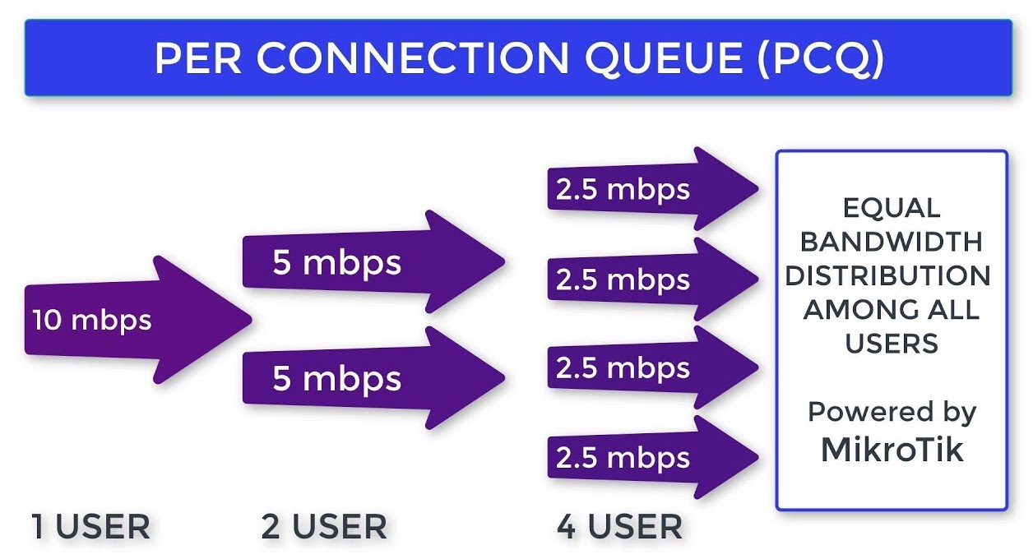
Theory – What is QoS – key terms
Nicky Verslycken
QoS for streaming and live internet calls
Mikrotik PCQ
PCQ = Per Connection Queuing
dynamically equalize or shape traffic for multiple users
Notes:
Per Connection Queue (PCQ) is a queuing discipline that can be used to dynamically equalize or shape traffic for multiple users, using little administration. It is possible to divide PCQ scenarios into three major groups: equal bandwidth for a number of users, certain bandwidth equal distribution between users, unknown bandwidth equal distribution between users.

Slide 12
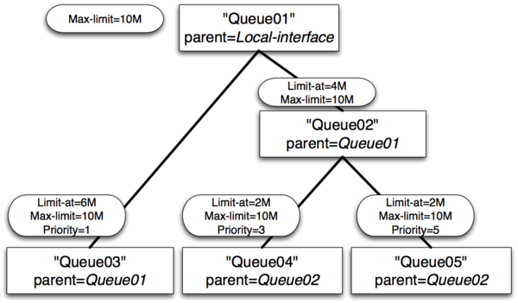
Theory – What is QoS – key terms
Nicky Verslycken
QoS for streaming and live internet calls
Queue tree
Hierarchical queue to limit bandwidth per target
Notes:
MikroTik's Queue Tree is a hierarchical queue mechanism that allows network administrators to more granularly control and allocate available bandwidth to different users, devices, or services. It is particularly useful in larger networks with diverse traffic types that require different levels of priority and quality of service.
The Queue Tree is based on a hierarchical tree structure, with each node representing a specific queue that can be further divided into child queues. Each queue in the tree is assigned a specific priority level, bandwidth limit, and other QoS parameters.
One of the key benefits of Queue Tree is its ability to apply different queueing rules to different traffic flows, based on factors such as source IP, destination IP, or port number. This allows for a more granular allocation of bandwidth and QoS settings for different types of traffic, such as VoIP, video streaming, or web browsing.
Queue Tree also allows for the use of different queueing disciplines, such as PCQ or HTB, which can further enhance the flexibility and efficiency of bandwidth management.
Overall, Queue Tree is a powerful and flexible tool for managing bandwidth and QoS in complex networks, particularly those with diverse traffic types and multiple user groups.

Slide 13
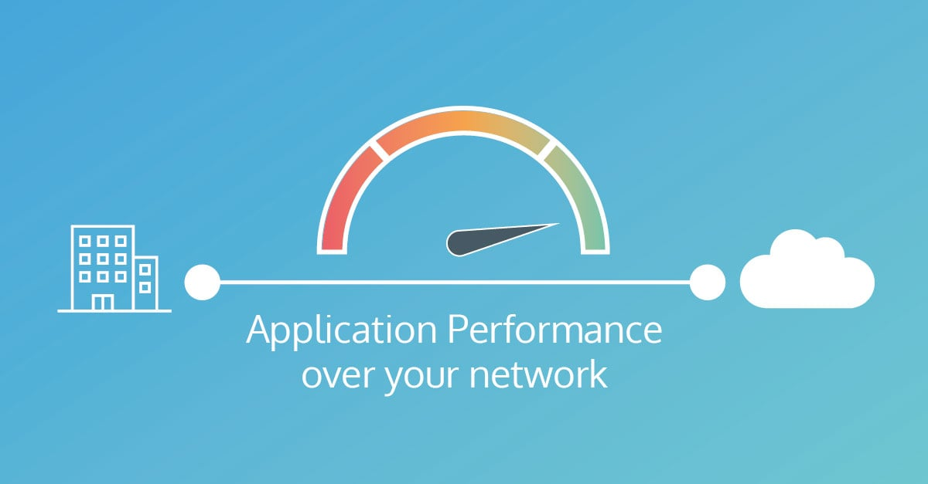
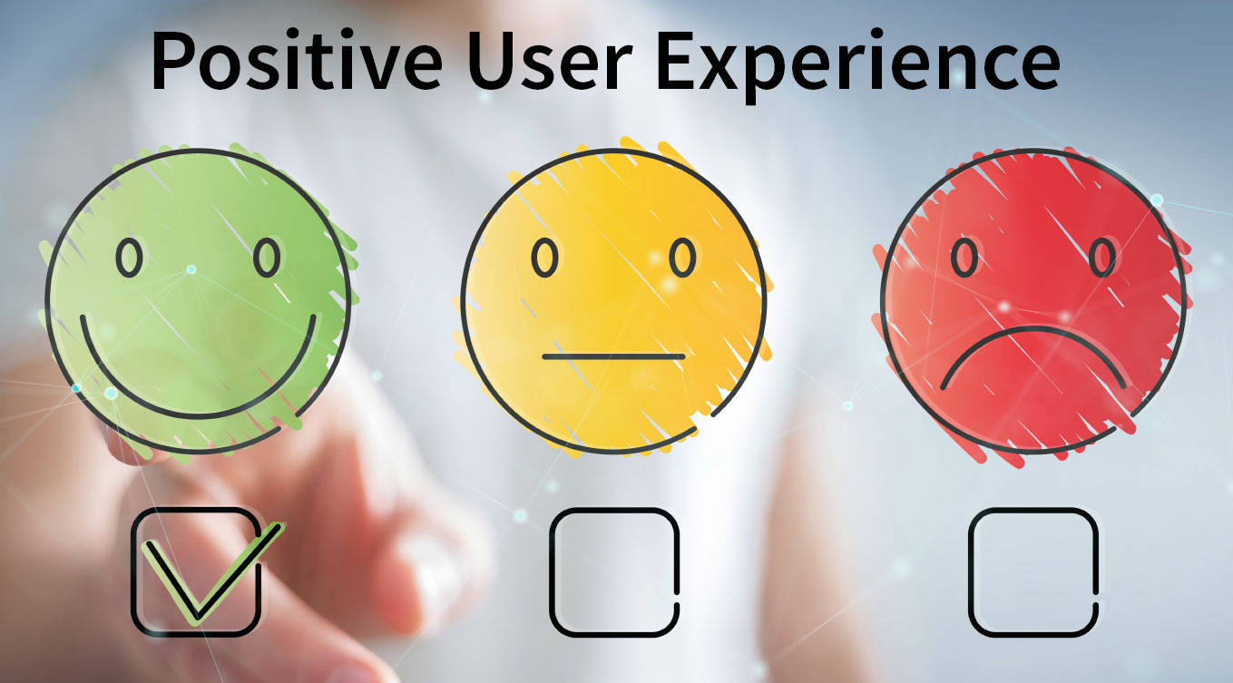
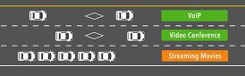

Theory – Why using QoS
Nicky Verslycken
QoS for streaming and live internet calls
You should use QoS in your network to ensure that critical traffic receives priority and is delivered reliably, even during times of network congestion.
Prioritization of traffic
Cost savings
Better network performance
Enhanced user experience
Notes:
Here are 4 reasons why you should make use of QoS:
Prioritization of traffic: QoS allows you to prioritize different types of traffic, so you can ensure that critical traffic like voice or video conferencing traffic is prioritized over less important traffic like file downloads, media streaming or web browsing.
Better network performance: By ensuring that critical traffic gets the necessary bandwidth and network resources, QoS can improve overall network performance and reduce delays or jitter in real-time traffic.
Cost savings: QoS can help optimize bandwidth usage by ensuring that critical traffic is given priority. This can help reduce the need for additional bandwidth or network resources, potentially saving your organization money.
Enhanced user experience: QoS can help improve the user experience for real-time applications, such as video conferencing or online gaming, by ensuring that the traffic is delivered reliably and with minimal delay.
Overall, QoS is an essential feature for any organization that relies on networked services and wants to ensure that critical traffic is given priority and delivered reliably, even during times of network congestion.

Slide 14


Theory – Why using QoS
Nicky Verslycken
QoS for streaming and live internet calls
The result of QoS create a better experience of the network what makes people happier overall.
Happy users
Happy IT staff
Notes:
QoS can make a difference how ICT services are experienced

Slide 15
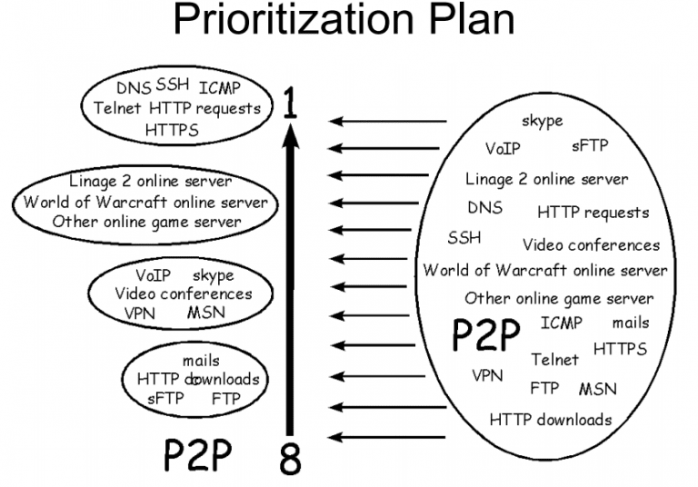
Theory – How to implement QoS
Nicky Verslycken
QoS for streaming and live internet calls
Step 1:
Study your network traffic and decide what prioritizing and bandwidth you want to give to what traffic
Notes:
To implement QoS on a MikroTik router, you can use the MikroTik RouterOS QoS feature. Here are the general steps:
Identify your network traffic:
First, you need to identify the types of traffic on your network that require QoS. For example, you may want to prioritize voice traffic, video streaming traffic, or online gaming traffic.
Create a traffic classification, once you have identified your network traffic, you need to create a traffic classification for each type of traffic. This can be done using the MikroTik RouterOS firewall filter rules.

Slide 16
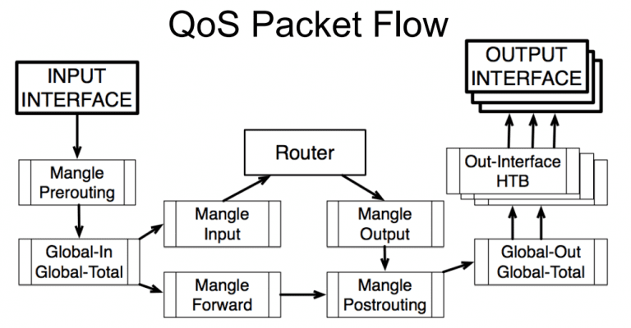
Theory – How to implement QoS
Nicky Verslycken
QoS for streaming and live internet calls
Step 2:
Create the necessary firewall rules:
Address list
Mangle rules
Filter rules
L7 Protocols
Notes:
To implement QoS on a MikroTik router, you can use the MikroTik RouterOS QoS feature. Here are the general steps:
Create a traffic marking
After creating traffic classifications, you need to create traffic markings for each traffic class. Traffic marking is the process of tagging each packet with a specific mark value.

Slide 17
Theory – How to implement QoS
Nicky Verslycken
QoS for streaming and live internet calls
Step 3:
Configure Queue:
Que type
Queue tree
Simple Queue
Notes:
To implement QoS on a MikroTik router, you can use the MikroTik RouterOS QoS feature. Here are the general steps:
Create a traffic queue:
Next, you need to create traffic queues for each traffic class. Traffic queues define the bandwidth limits and priorities for each traffic class.
Apply the traffic queue to the interface: Finally, you need to apply the traffic queue to the interface that connects to the network where the traffic is flowing.

Slide 18
Usage explanation
Nicky Verslycken
QoS for streaming and live internet calls
Recommended bandwidth for Youtube as example
Type | Video Bitrate, Standard Frame Rate (24, 25, 30) | Video Bitrate, High Frame Rate (48, 50, 60)
8K | 100 - 200 Mbps | 150 to 300 Mbps
2160p (4K) | 44–56 Mbps | 66–85 Mbps
1440p (2K) | 20 Mbps | 30 Mbps
1080p | 10 Mbps | 15 Mbps
720p | 6.5 Mbps | 9.5 Mbps
480p | 2.5 Mbps | 4 Mbps
360p | 1 Mbps | 1.5 Mbps
Notes:
This is an example of recommended bandwidth for Youtube, other streaming services are kind of in the same ranges
For our setup we will configure we will assume that we have 10Mb bandwidth per router

Slide 19
Basic router configuration
Nicky Verslycken
QoS for streaming and live internet calls
Connect to your Mikrotik device by MAC
Reset your router to default configuration as such that it will work as a router (CPE)
Test your internet connectivity
Once you have internet connectivity on your computer we will start the lab.
Notes:
When connected to the router reset your router so it’s completely empty with no users, or default configuration, if you have config on your device you want to keep please create a backup or export first before resetting your device

Slide 20
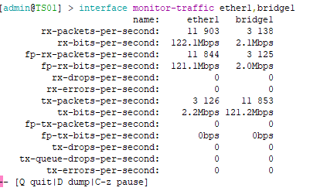
Usage explanation
Nicky Verslycken
QoS for streaming and live internet calls
Monitor your interface speed
/interface monitor-traffic ether1
Test some speed
Go to https://t.ly/UpcKv
And disable your sound before playing the video ;-)
Play the movie and watch the traffic monitor in your Mikrotik terminal.
Notes:
When watching the traffic you will notice that the speed is above 2Mb

Slide 21
Firewall – Address list
Nicky Verslycken
QoS for streaming and live internet calls
Adding the streaming server addresses to the firewall address list of our Mikrotik router
/ip firewall address-list
add address=176.58.30.0/24 list=addrl-TVO\
comment=TVoost-non-live-content-streaming-servers
add address=93.123.38.0/24 list=addrl-TVO\
comment=TVoost-live-content-streaming-servers
add address=176.58.31.0/24 list=addrl-TVO\
comment=TVoost-live-content-streaming-servers
We will use this addresses in our firewall mangle rules to mark our connections
Notes:
In this practice we will add the ip spaces of the streaming servers of a local news channel and website
https://www.tvoost.be
TVoost translated to English would be TVeast but you have to use TVoost, just to know
you can use the google translate plugin in your browser if necessary ;-)

Slide 22
Firewall - Mangle rules
Nicky Verslycken
QoS for streaming and live internet calls
Adding the mangle rule that will mark the connections to TVoost based on the Address list
/ip firewall mangle
add action=mark-connection chain=prerouting connection-mark=no-mark\ connection-state=new dst-address-list=addrl-TVO log=yes\
log-prefix=cm_tvo new-connection-mark=cm_tvo passthrough=yes\
comment=Connections-mark_to_TVoost
We will use this mangle rule to mark our packets later in the traffic flow
Notes:
With this rule will all the connections made to the addresses in the address list “addrl-TVO” be marked with the connection mark “cm_tvo”.
We will use that connection mark in a Mangle rule to mark all the packets of that connection
We also check that it has to be a new connection so the firewall only mark the new connections and not have to look to connection in a further state then

Slide 23
Firewall - Mangle rules
Nicky Verslycken
QoS for streaming and live internet calls
Adding the mangle rule that will mark the connections of all the udp traffic that is not from TVoost
/ip firewall mangle
add action=mark-connection chain=prerouting connection-mark=no-mark\
connection-state=new dst-address-list=!addrl-TVO log=yes\
log-prefix=cm_udp new-connection-mark=cm_udp passthrough=yes\
protocol=udp dst-port=!53 dst-address=!255.255.255.255\
comment=Connection-mark_for_other_udp_traffic
We will use this mangle rule to mark our packets later in the traffic flow
Notes:
Note: TVoost doesn’t use UDB but TCP for their streaming but in that way we can filter TVoost and other UDP traffic to the client
With this mangle rule we will mark al UDP connections that don’t are with addresses in the Address list “addrl-TVO”, later we will mark the packets of this connections

Slide 24
Firewall - Mangle rules
Nicky Verslycken
QoS for streaming and live internet calls
With this mangle rule we will add a mark on the packets of the connections with cm_tvo
/ip firewall mangle
add action=mark-packet chain=prerouting connection-mark=cm_tvo log=yes log-prefix=pm_tvo new-packet-mark=pm_tvo passthrough=yes\
comment=Packet-mark_for_Tvoost
We will use this mangle in our Queue tree
Notes:
Each packet of a marked connection with “cm_tvo” will be marked as “pm_tvo”

Slide 25
Firewall - Mangle rules
Nicky Verslycken
QoS for streaming and live internet calls
With this mangle rule we will mark all the packets with the connection mark cm_udp
/ip firewall mangle
add action=mark-packet chain=prerouting connection-mark=cm_udp log=yes log-prefix=pm_udp new-packet-mark=pm_udp passthrough=yes/
comment=Packet-mark_for_UDP_traffic
We will use this mangle in our Queue tree
Notes:
Each packet of a marked connection with “cm_tvo” will be marked as “pm_tvo”

Slide 26
Firewall – Queue type
Nicky Verslycken
QoS for streaming and live internet calls
With this configuration we will add 3 PCQ Queue types to use later in Queue tree
/queue type
add kind=pcq name=pcq-tvo pcq-burst-rate=2M pcq-burst-threshold=2M\
pcq-burst-time=1m pcq-classifier=dst-address pcq-rate=512k
add kind=pcq name=pcq-udp pcq-burst-rate=10M pcq-burst-threshold=6M\
pcq-burst-time=1m pcq-classifier=dst-address pcq-rate=6M
add kind=pcq name=pcq-other pcq-burst-rate=10M\
pcq-burst-threshold=5M pcq-burst-time=1m\
pcq-classifier=dst-address pcq-rate=5M
…
Notes:
This PCQ Queue types will be used in our end-gloal configuration Queue tree, we set this PCQ rules to limit the traffic per user.

Slide 27
Firewall – Queue tree
Nicky Verslycken
QoS for streaming and live internet calls
With this configuration we will add the parent Queue tree
/queue tree
# please change the parent parameter to match your interface name of your bridge or ethernet interface where your LAN is connected to
add name=QT-ether1-wan parent=bridge-LAN priority=1 limit-at=10M\
max-limit=10M comment=parent_queue_tree_item
Next we add the child items
Notes:
This parent Queue limit the bandwidth of the interface, in this case “bridge-LAN”

Slide 28
Firewall – Queue tree
Nicky Verslycken
QoS for streaming and live internet calls
This are the child Queue tree items we need to add
/queue tree
add name=QT-tvo packet-mark=pm_tvo parent=QT-ether1-wan queue=pcq-tvo\ comment=TVoost_queue_tree_item
add name=QT-udp packet-mark=pm_udp parent=QT-ether1-wan priority=1\ queue=pcq-udp comment=UDP_queue_tree_item
add name=QT-other packet-mark=no-mark parent=QT-ether1-wan priority=2\ queue=pcq-other comment=Other_traffic_queue_tree_item
Notes:
These child Queues will apply the bandwidth limitations to the clients depending of type of traffic

Slide 29

Testing
Nicky Verslycken
QoS for streaming and live internet calls
Test what speed you have to set in the Queue tree QT-tvo
to have a flued low-quality livestream

Slide 30
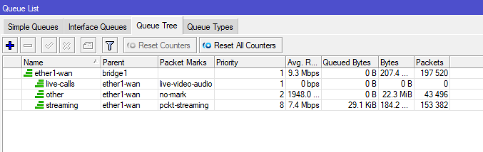
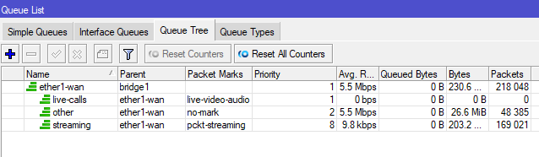
Simple queues and queue tree
Nicky Verslycken
QoS for streaming and live internet calls
Notes:
Discuss the result

Slide 31

Quiz
Nicky Verslycken
QoS for streaming and live internet calls
I have one more task for you …
Please fill in my quiz
URL: https://t.ly/i7s0e
Thanks for your attention and success!
Notes:
The first time you login on the router it will ask you to set the password, please do so

